Slide 1

Movie Analysis
PRESENTED BY :
Panjala Rohit Nunna Siva Nihanth
BATCH NO : 493

Slide 2
Business Problem
Analyze movie industry data to identify revenue trends, audience preferences, and genre performance.
Business problem: Production companies struggle to identify factors affecting movie success and profitability.
Goal: Build an interactive dashboard for data-driven decision making.

Slide 3
Dashboard 1 – Movie Overview & Time Trends-------------------------------
KPIs included: Total Movies, Total Revenue, Avg IMDb Rating, Avg Runtime.
Visuals show yearly movie releases, revenue growth, runtime trends, and rating trends.
Insight: Movie releases and revenue increased significantly over time.

Slide 4
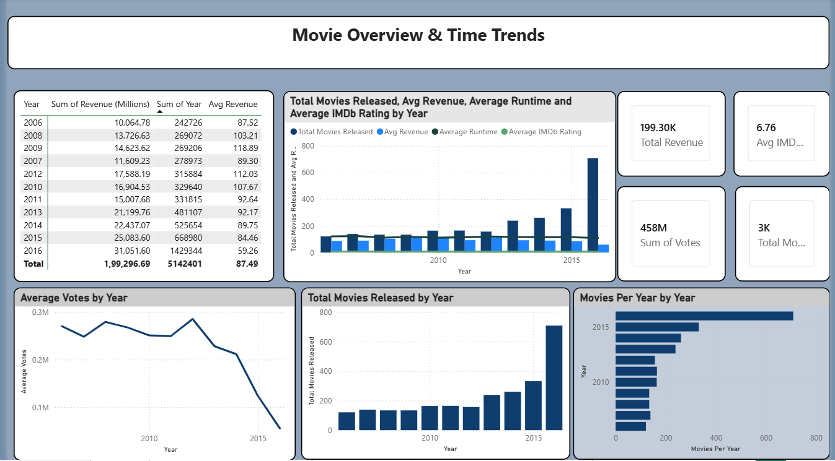

Slide 5
Dashboard 2 – Genre & Rating Analysis
Analyzed movie distribution across genres.
Compared genre-wise revenue, ratings, votes, and metascores.
Insight: Action and Adventure genres generated high revenue while Drama received higher ratings.

Slide 6
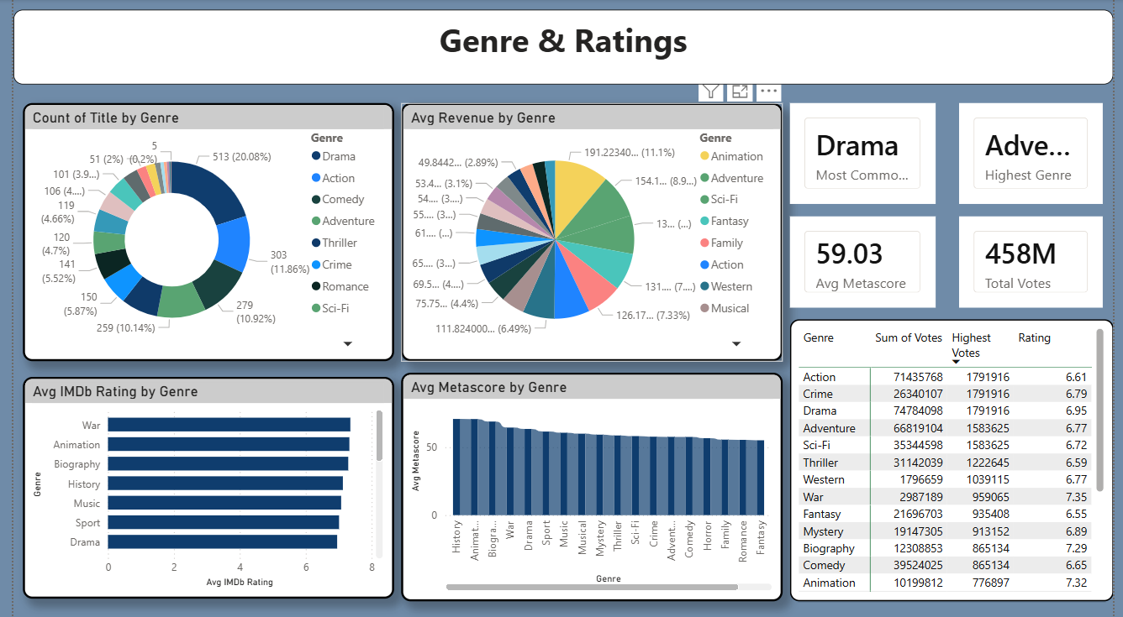

Slide 7
Dashboard 3 – Top Performers & Box Office Insights
Identified top directors and movies based on revenue and votes.
Scatter plots used to compare ratings vs revenue.
Insight: A few blockbuster movies contribute major revenue share.

Slide 8
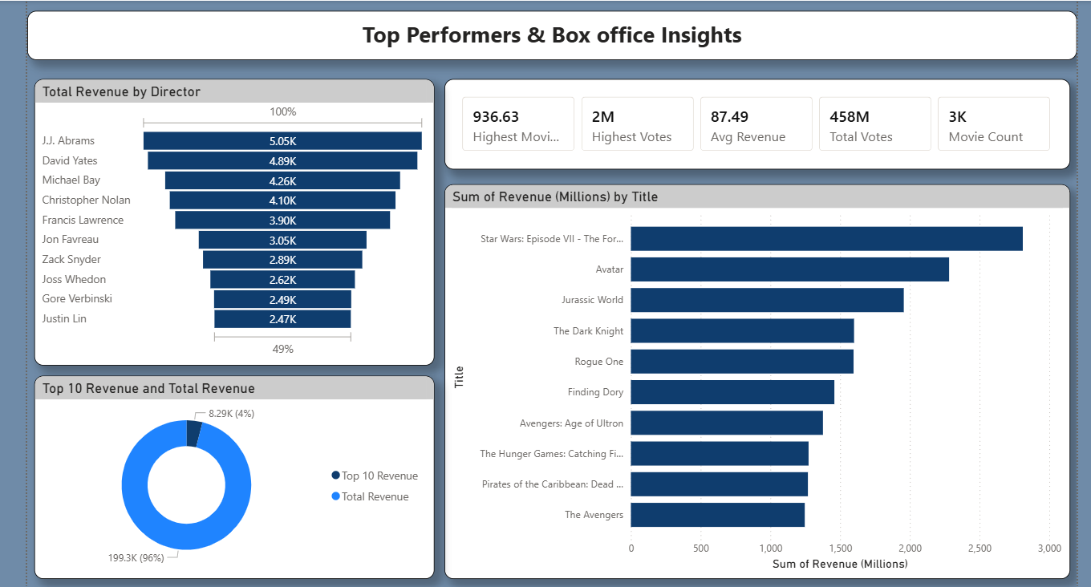

Slide 9
Dashboard 4 – Correlation & Advanced Metrics
Analyzed relationships between revenue, ratings, runtime, and votes.
Studied revenue trends by genre and year.
Insight: Higher audience engagement often leads to higher revenue.

Slide 10
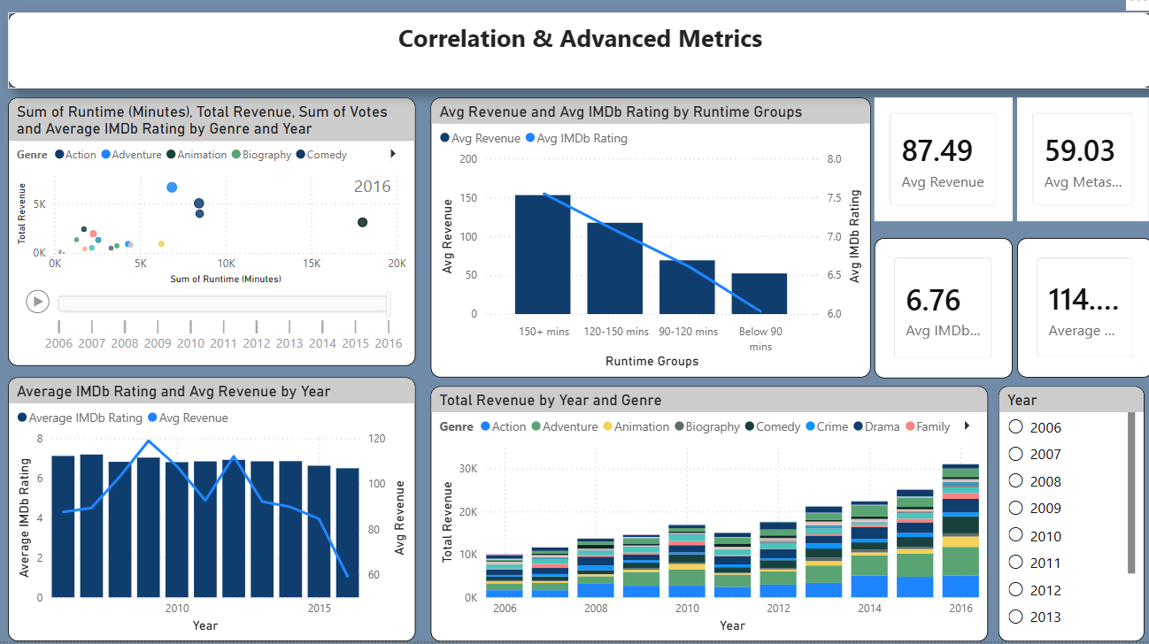

Slide 11
Key Business Insights
Audience votes strongly influence movie popularity.
Certain directors consistently perform better.
Ratings and revenue show a partial positive correlation.
Genre trends change over time based on audience preference.

Slide 12
Recommendations & Challenges
Recommendations: Invest in high-performing genres and audience-focused marketing.
Use analytics for content planning and investment decisions.
Challenges: Data cleaning, KPI creation, and dashboard interactivity management.

Slide 13

THANK YOU

